Slide 1
How JS Works Behind The Scenes

Slide 2
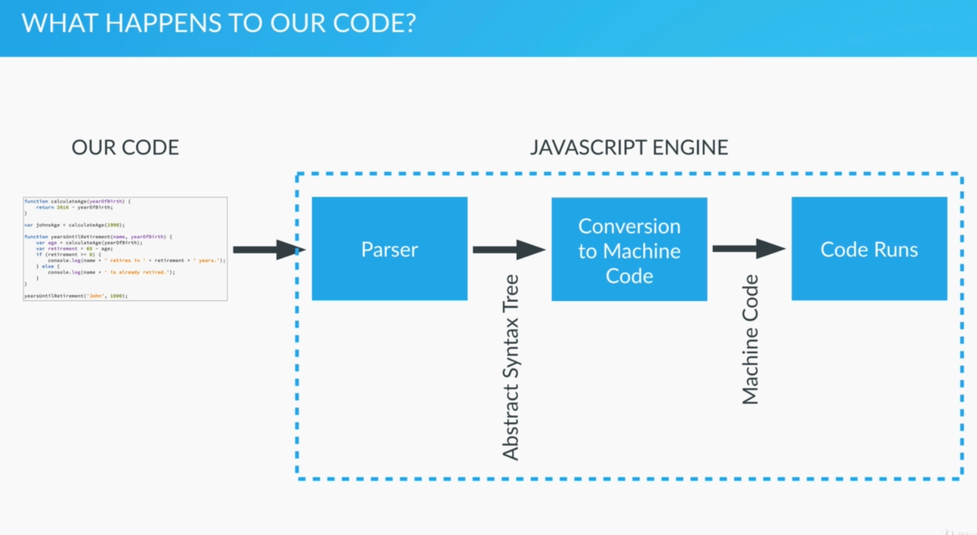
How Our Code Is Executed JavaScript Parsers and Engines

Slide 3
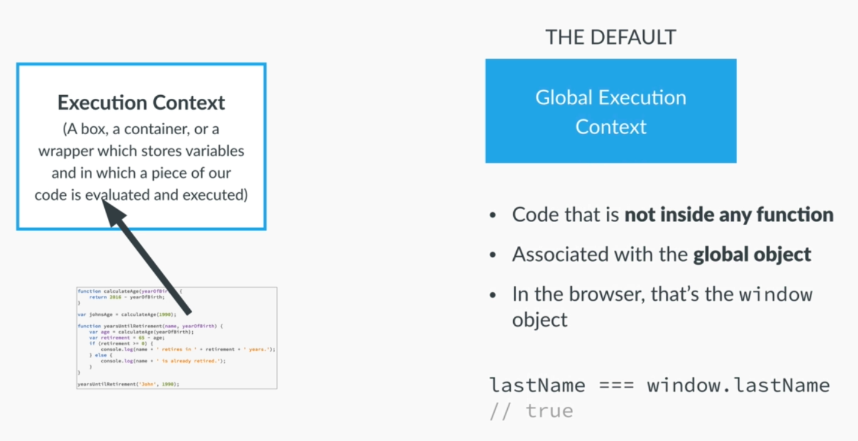
Execution Context

Slide 4
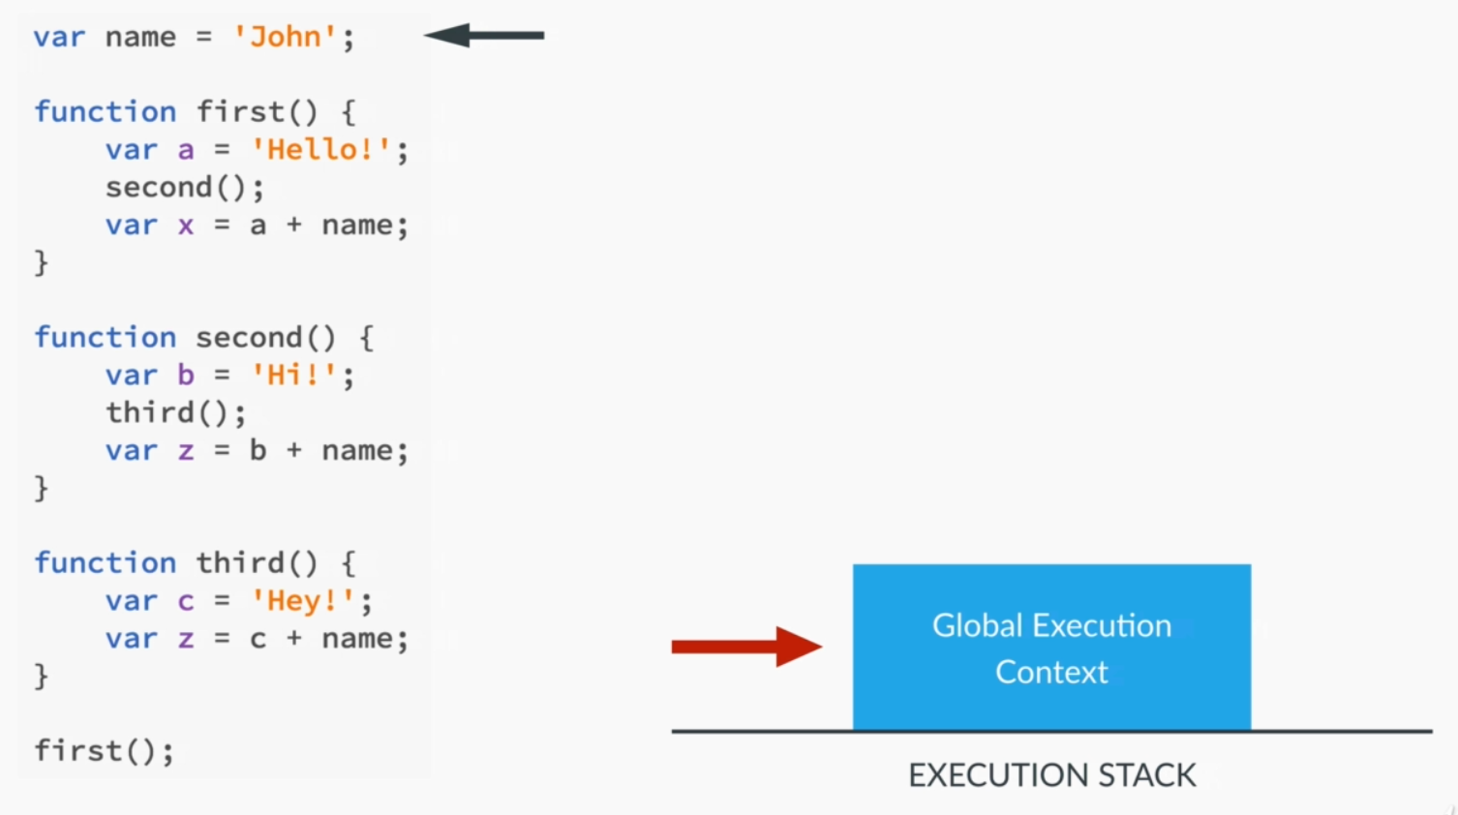
Execution Stack

Slide 5
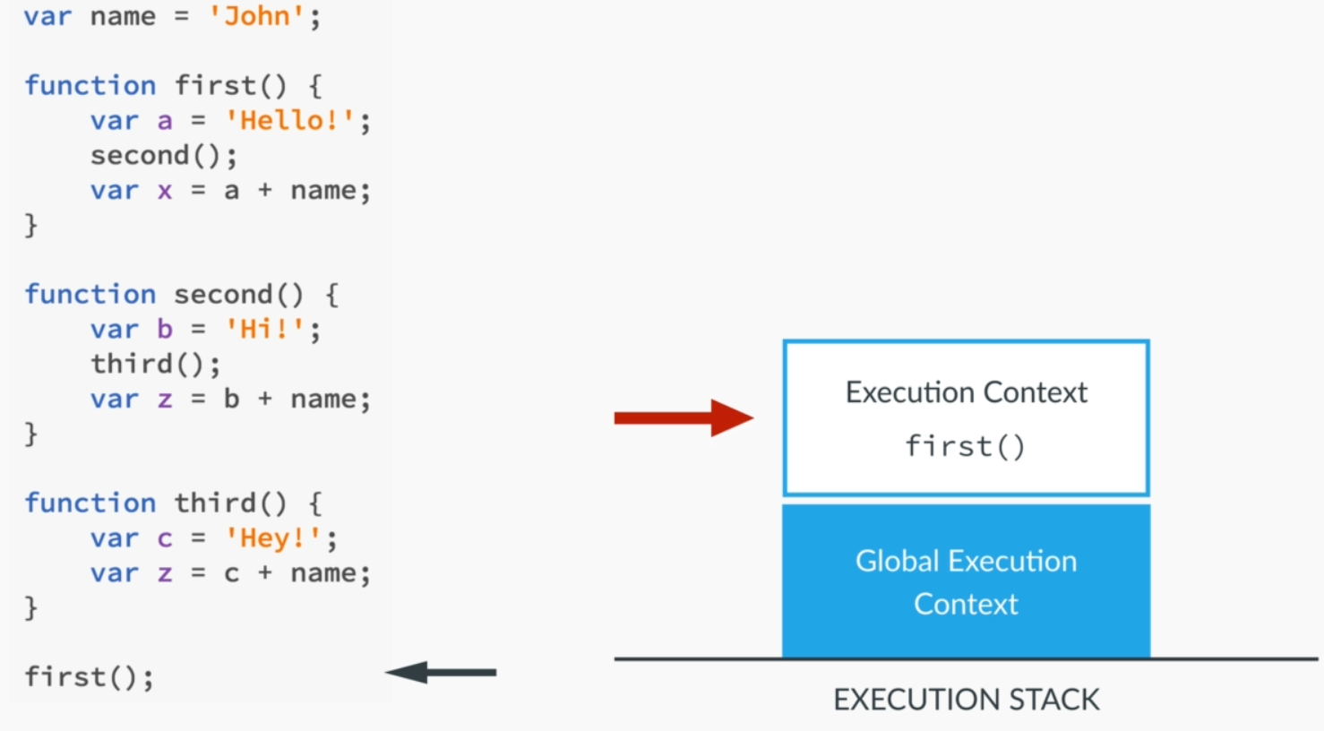
Execution Stack

Slide 6
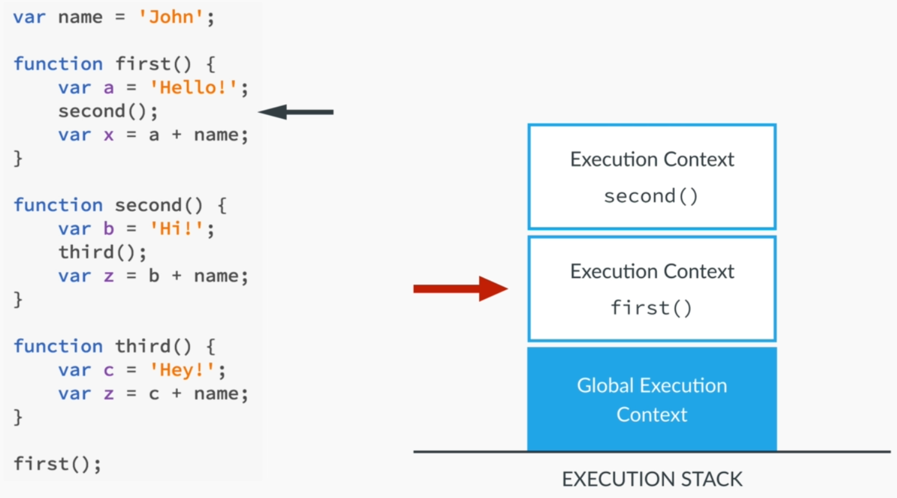
Execution Stack

Slide 7
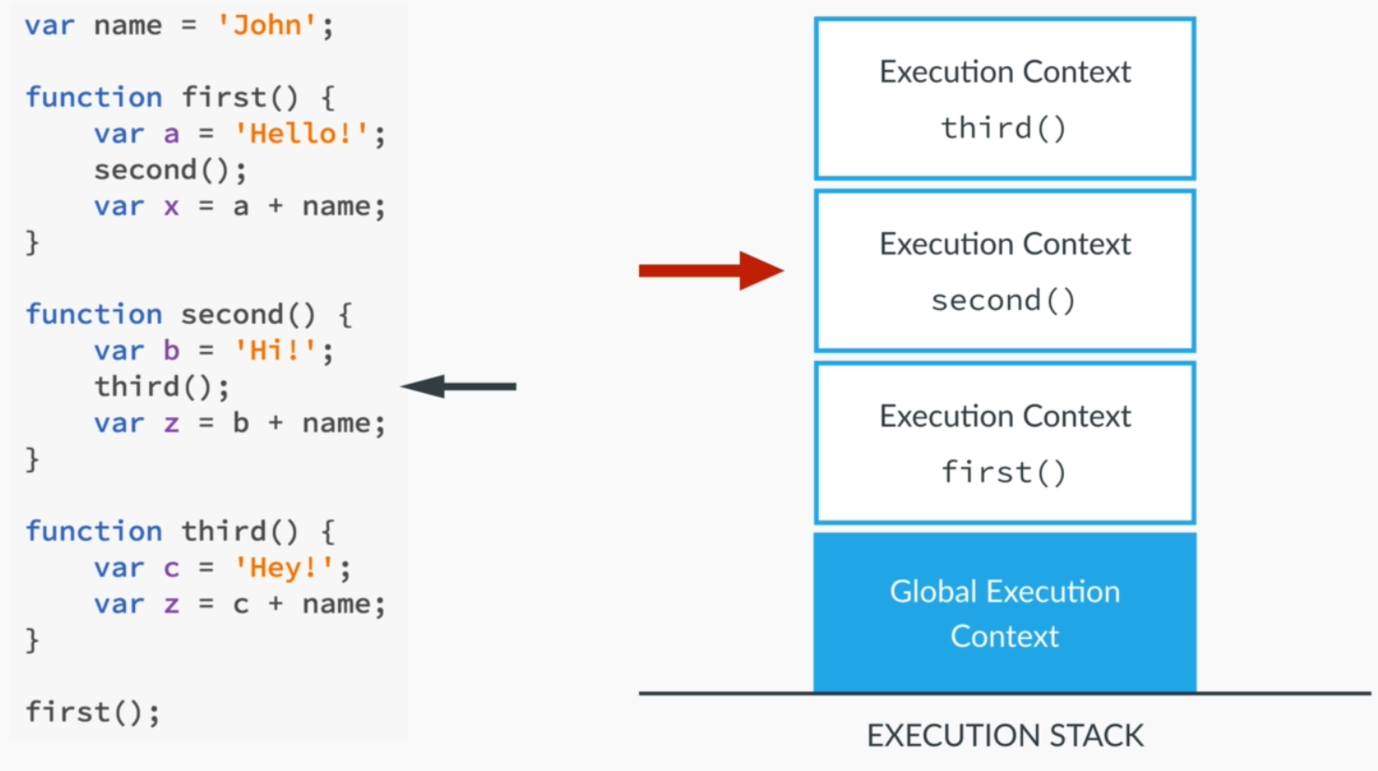
Execution Stack

Slide 8
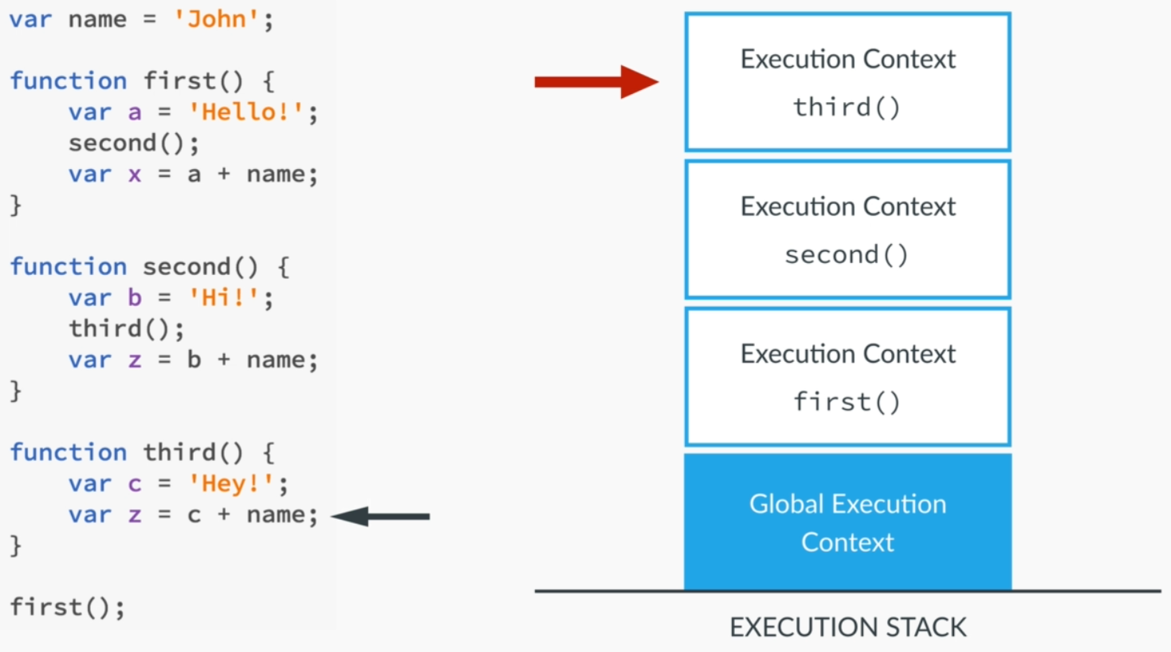
Execution Stack

Slide 9
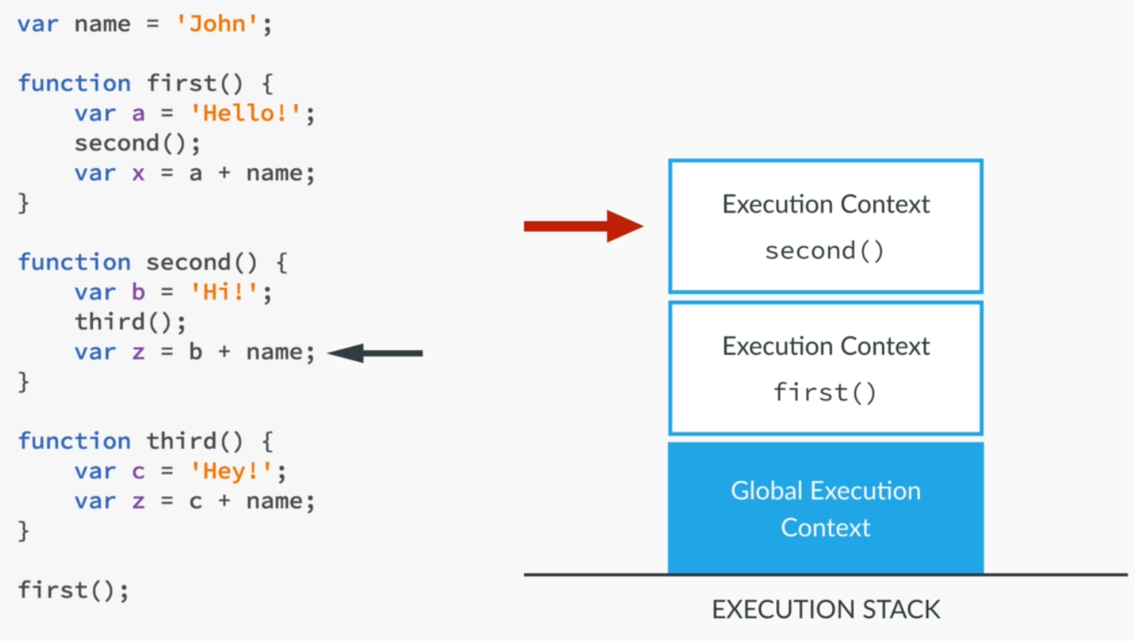
Execution Stack

Slide 10
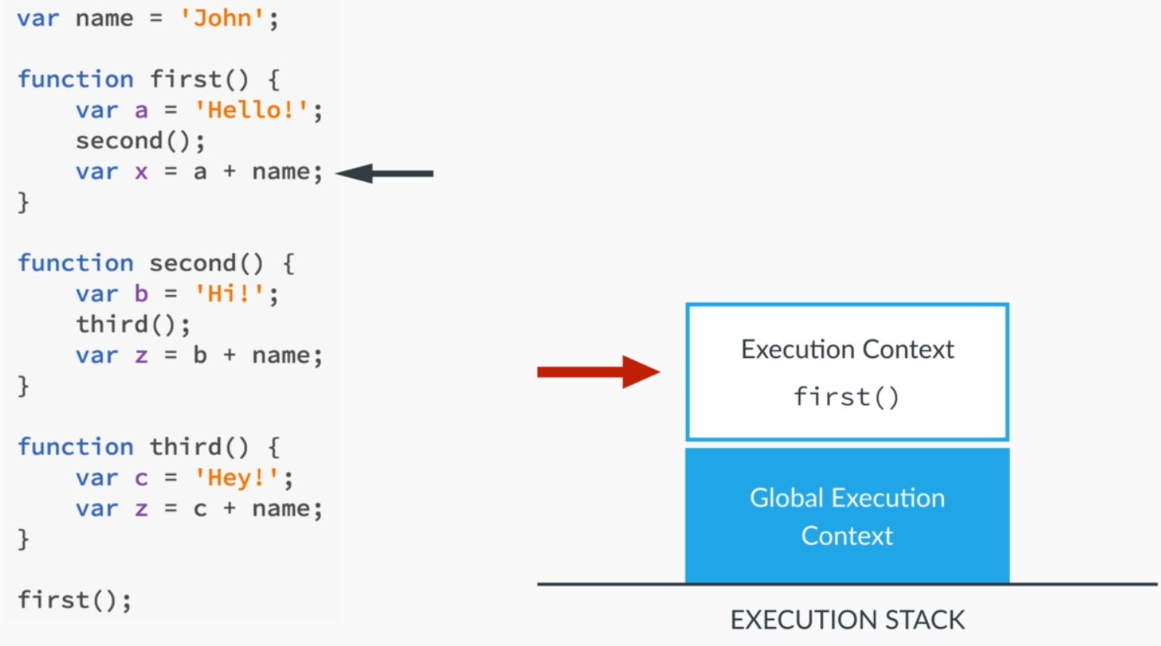
Execution Stack

Slide 11
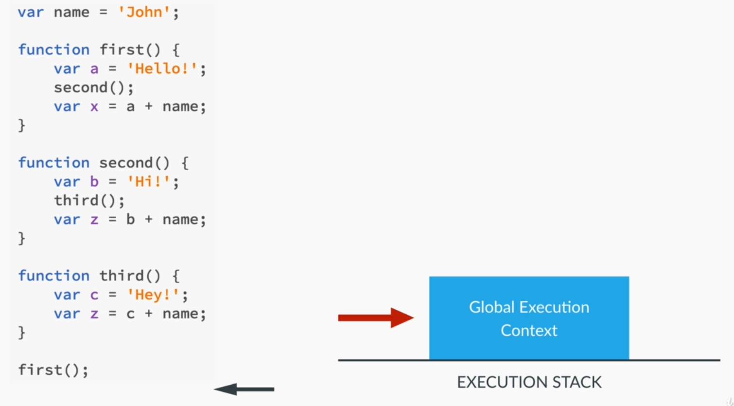
Execution Stack

Slide 12
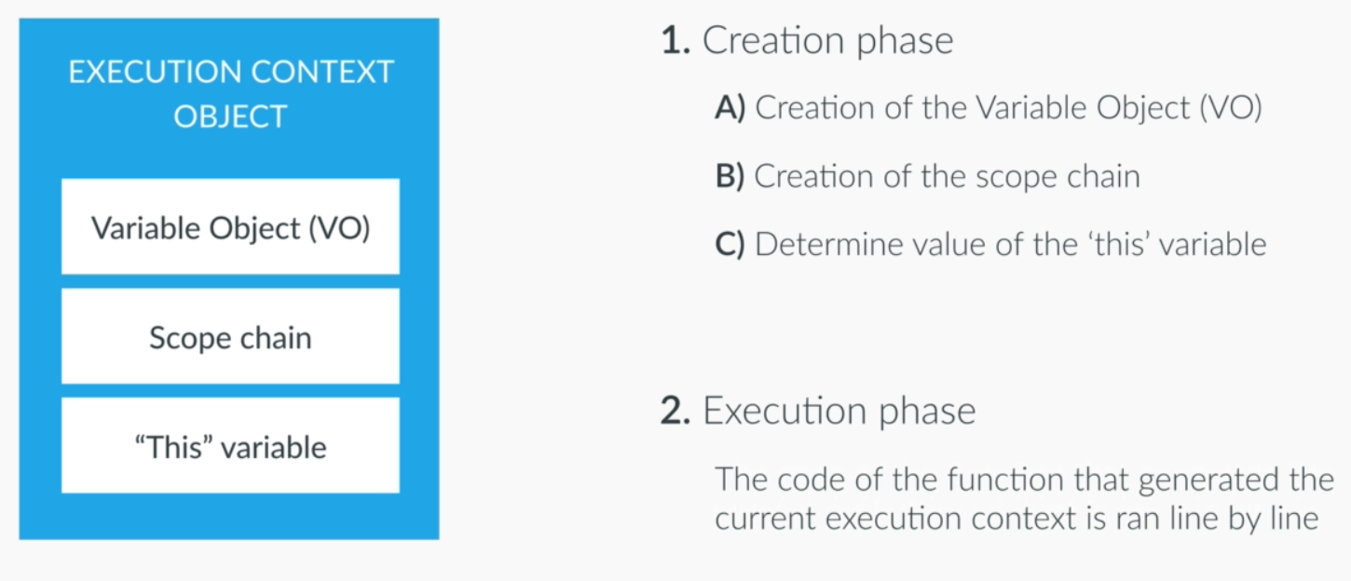
Execution Contexts in Detail
Notes:
We can associate execution context with an object. In case of GEC the object is window. This object has three properties.
VO: contains function arguments, inner variable declarations and function declarations
SC: contains current VO as well as the VO of all of it’s parents.
Putting the new Excution context on top of execution stack happens in two phases. Creation & Execution

Slide 13
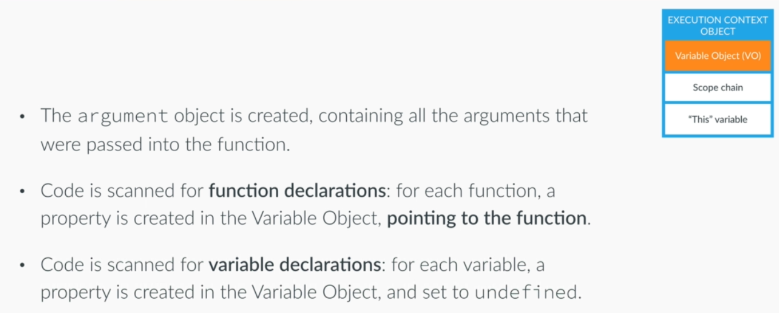
Variable Object
Notes:
VO: contains function arguments, inner variable declarations and function declarations

Slide 14
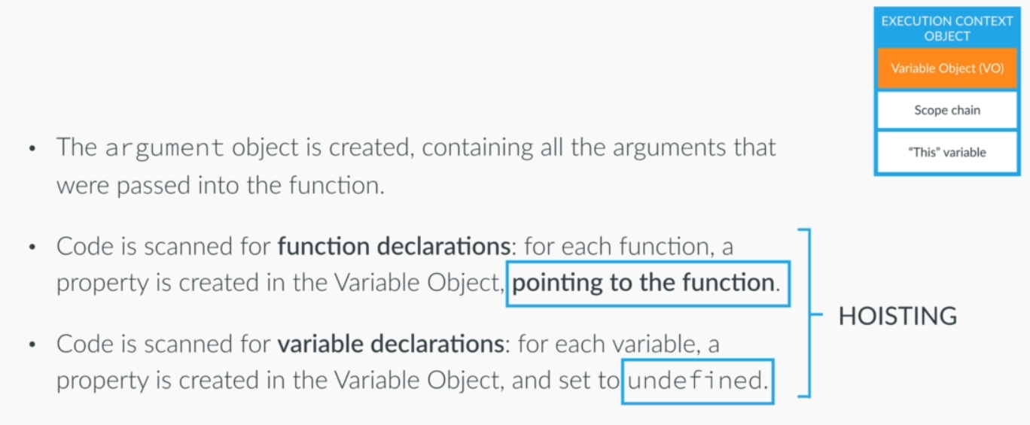
Variable Object
Notes:
Functions and variables are hosited in JS which means they are available before the execution phase starts.
Functions are already defined before the execution phase starts.
Variables will only be defined in the execution phase.

Slide 15
Creation and Execution Phases and Hoisting

